Slide 1
EmPower your BI Architecture
Riccardo Perico

Slide 2



Organizers
GetLatestVersion.it

Slide 3











Sponsors

Slide 4




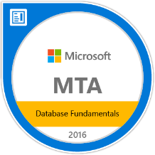




Riccardo Perico rperico@solidq.com | @R1k91 |
Data Platform & BI Specialist @
10 years in Microsoft «Data Realm»
MCP: MTA, MCSA
Speaker at Azure Saturday, SQL Saturday and DIAD tutor

Slide 5
Agenda? The Right Questions
What’s Storage Mode and which one best suits to me?
Do I need an On-premises Data Gateway?
How to refresh my data?
Is it just on-cloud solution?
Can I «encapsulate» PowerBI?
Do I need to care about dataflows?
Can I have some advisable scenarios?

Slide 6
What’s Storage Mode and which one best suits to me?

Slide 7



Storage Mode: Import Mode
Data Model Cached into RAM

Slide 8

Storage Mode: Import Mode
Model Cached inside Power BI Service
High Compression thanks to VertiPaq (*)
Full Power BI functionalities and DAX functions support
Multiple Data Sources mashup (all available)
10 GB model size for PREMIUM / 1 GB for PRO

Slide 9
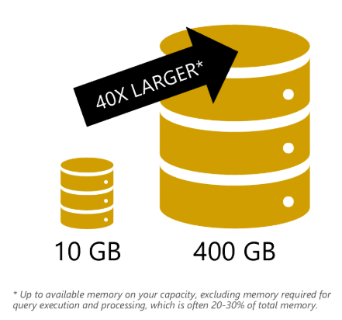
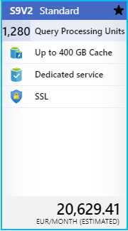

Large models for Power BI Premium
Notes:
PBIX upload is still limited to 10 GB
To grow over 10 GB setup incremental refresh
Needed PowerShell configuration of dataset on Azure Premium Files (Azure Storage Account)
Limit set by capacity memory

Slide 10
Storage Mode: Direct Query
Schema only

Slide 11
Storage Mode: Direct Query
Limited data sources
Not full Power Query and DAX support
Pay attention to performance (1 render = 1 query)
Overcome model size limits
Real-time / Near Real-time scenarios
Notes:
Direct Query should be used when there’s no alternative way because is always slower than VertiPaq.

Slide 12
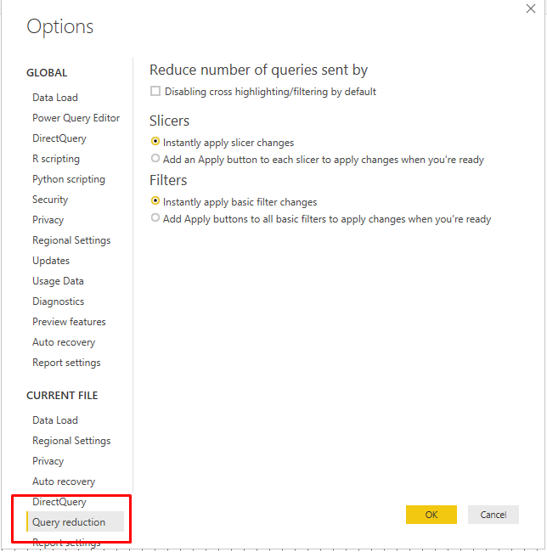
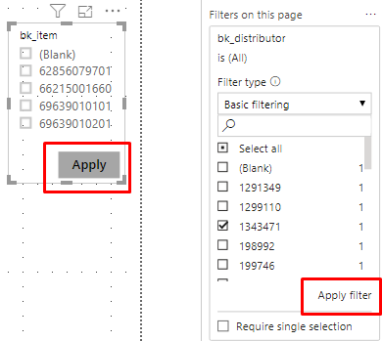
Direct Query: Quick Tip

Slide 13
Storage Mode: Live Connection
PowerBI acts just like an interface

Slide 14
Storage Mode: Live Connection
Data Sources: AAS, SSAS Tabular/Multidimensional and PBI dataset
Data Preparation and Data Modeling done in the source
Interaction with report = DAX query sent to source
Overcome model size limits
Partitioned Load
Tends to be faster than DQ
Never prefer «Import» over «Live Connection» for supported sources
Notes:
- If gateway is needed the user specified in the data source must be Tabular Instance Admin.
- The Live Connection does impersonation configuring also UPN Mapping.
- Report Level Measures if SSAS Tabular or Azure AS.

Slide 15
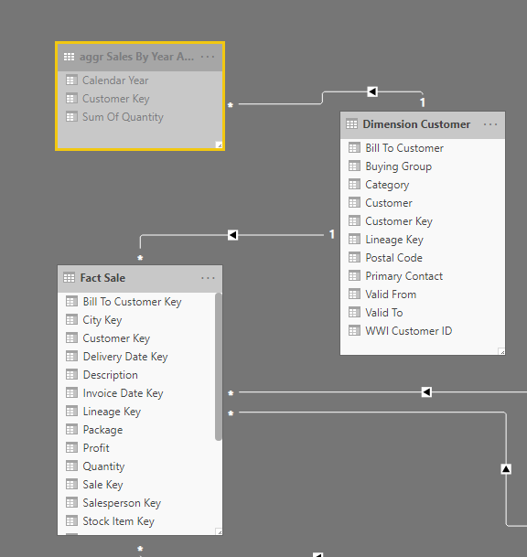
Storage Mode: Composite Mode
Import Mode
Dual Mode
Direct Query

Slide 16
Do I need an On-premises Data Gateway?

Slide 17

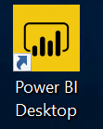


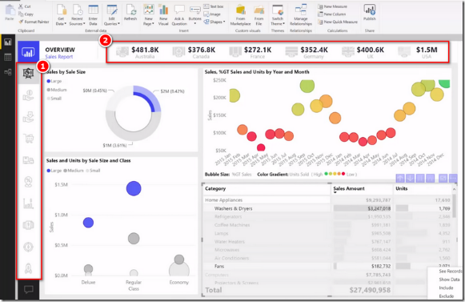


Let’s draw a typical scenario
Publish

Slide 18



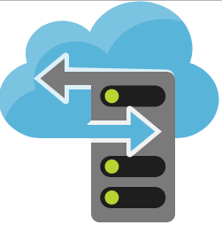
On-Prem Data Gateway is the way
On-prem Data Gateway
Azure Service Bus
Refresh Scheduler Service
Data Movement Service
Notes:
- Scheduler Service used to kick off a dataset refresh
- It calls Data Movement Service that reference the correct Azure Service Bus sending a query as request
- Service Bus manage a queue that is polled by the Gateway

Slide 19





2 Gateway types
On-premises data gateway (Enterprise)
On-premises data gateway (Personal mode)
All Storage Mode Support
Scheduled Refresh Support
Import Mode Support
Scheduled Refresh Support

Slide 20
Gateway: Architecture security
Credentials stored locally and in Power BI Service
Data Source credentials encrypted and stored in the cloud only gateway can decrypt
Gateway polling → No inbound port to open
Outbound port to open TCP: 443, 5671, 5672, 9530...9534

Slide 21
Gateway: Considerations
Keep gateways’ name/recovery key in a safe place (migration, take over and recovery)
Do not install Personal and then Enterprise
Sometimes 2 gateways are needed: Import + DQ/Live
Create a cluster for High-Availability: round robin or balanced load
On-premises data gateway app helps you
New Powershell 6 cmdlets to manage Gateway
Notes:
2 gateways: multiple domains, different types of storage mode due to their different load behavior

Slide 22
Demo Preview

Slide 23

On-prem & On-Cloud Mashup
?
X
On-prem Data Gateway
Azure Service Bus
1 Mashup Query On-Prem
1 Mashup Query On-Cloud
1 Mashup Query for both On-Prem and On-Cloud

Slide 24
Demo: Mashup and Gateway

Slide 25
How to refresh my data?

Slide 26
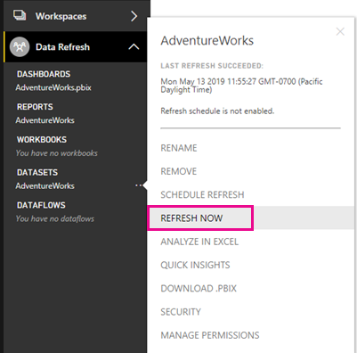
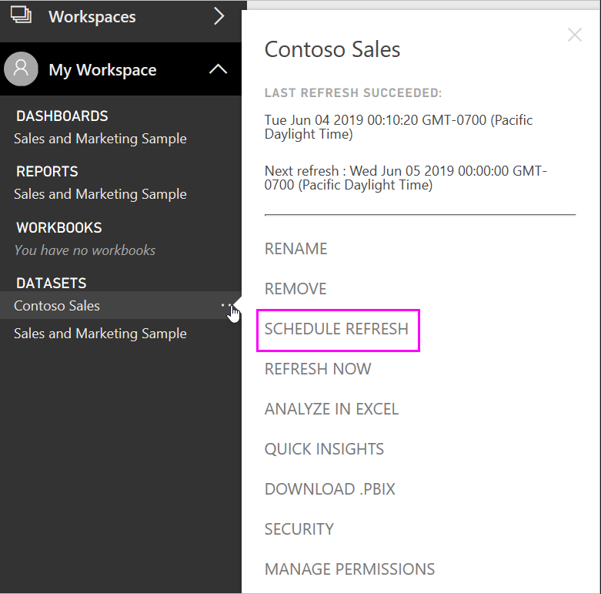
Data are old… let’s refresh!
Storage Mode | Refresh Needed
Import Mode Pro
Imp. Premium
Direct Query
Live Connection
Max Refresh Per Day | Max Refresh Time
8 | 2 hours
48 | 5 hours
- | -
- | -
+
Notes:
Refresh starts on a “best effort basis”.
Schedule is automatically deactivated in case of 4 consecutive failures.

Slide 27
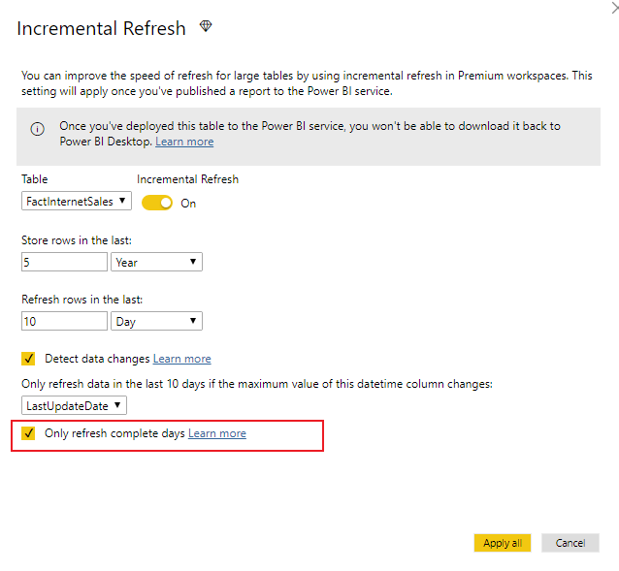
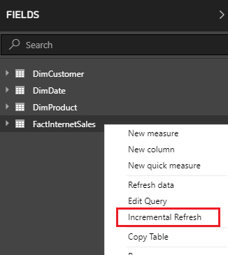
Too much data?

Slide 28

FOR PRO IS cOMIng

Slide 29
Is it just on-cloud solution?

Slide 30
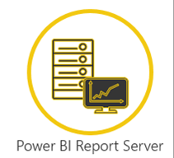
Cloud is not the only option
Publish / Upload

Slide 31
PBI Service Vs PBI Report Server
 | PBI Service | PBI Report Server
Deploy | Cloud | On-Prem
Licensing | Power BI Pro and/or Premium | PBI Premium or SQL Server EE + SA
Release Cycle | Every month | Every 4 months
Gateway Required | For on-prem source | No
Realtime Streaming | Yes | No
Dashboard & Quick Insights | Yes | No
Apps | Yes | No
Q&A | Yes | No
Analyze in Excel | Yes | No
Paginated reports | Yes | Yes
https://docs.microsoft.com/it-it/power-bi/report-server/compare-report-server-service

Slide 32
Can I «encapsulate» PowerBI?

Slide 33


Encapsulate Power BI: 2 options

Slide 34
Opt. 1: Embedded in SharePoint Online
Pros
Centralized UX
Easy setup
Cons
Only reports
Users won’t use service
Permissions management
Notes:
… > Embed > SP Online → copy the url
Add a page in SP with PowerBI object and then paste url
Permissions: see the page in SP and to be PBI pro user and report to be shared with me

Slide 35
Opt. 2: Power BI Embedded
Pros
Full custom application
Reports, Dashboards, Datasets and also Q&A
End user do not need a Power BI Pro License
Cons
Licensing: buckets of range renders
Registration and management
Not all service’s features
Web developer needed
Notes:
Features not available: alerts, subscriptions and usage metrics
Renders: open report, refresh, click on a column, filter, slice and dice…

Slide 36
Do I need to care about dataflows?

Slide 37
dataflows: as-is
Power Query
Date
Customer
Sales
Sales.pbix
Power Query
Date
Vendor
Purchases
Purchases.pbix

Slide 38

dataflows: a new paradigm
PQ in dataflows
Date
Customer
Sales
PQ in dataflows
Vendor
Purchases
Sales.pbix
Azure Data Lake Storage V2 (CDM)
Purchases.pbix

Slide 39
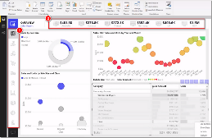

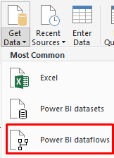
dataflows: 2 steps forward
Data Preparation
Data Modeling
Data Presentation
PQ in dataflows
Date
Customer
Sales
PQ in dataflows
Vendor
Purchases
Power BI Dataset
Azure Data Lake Storage V2 (CDM)

Slide 40
dataflows: pros
Centralization of data preparation (reusability and standardization)
Isolating refresh (1 table a time)
Attach an existing ADLS v2 (preview)
Speed up dataset refresh
Notes:
When saved to PBI storage:
They count on license’s storage
Can be accessed just by PowerBI

Slide 41
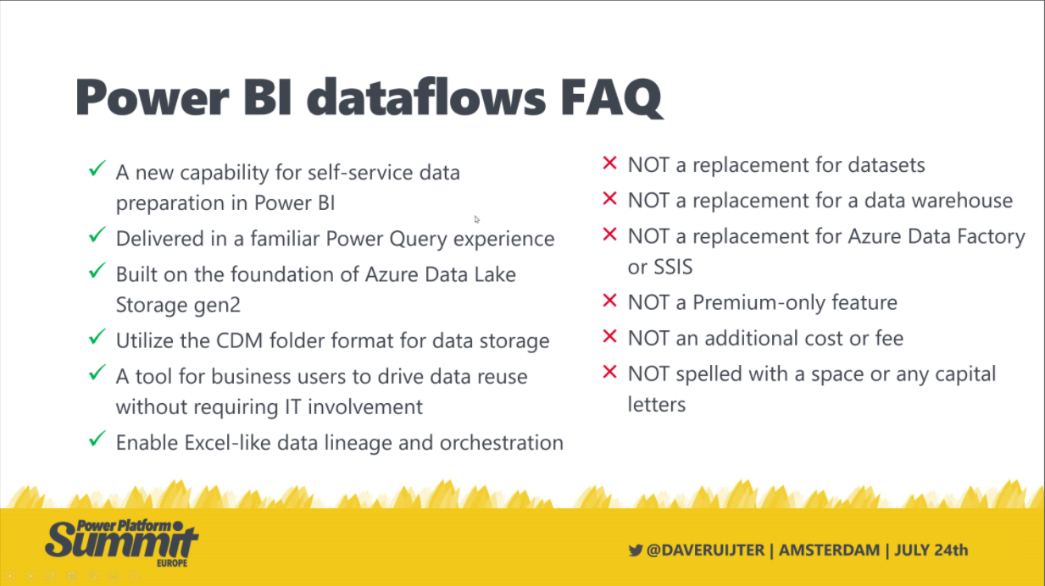
dataflows: summary pt. 1

Slide 42
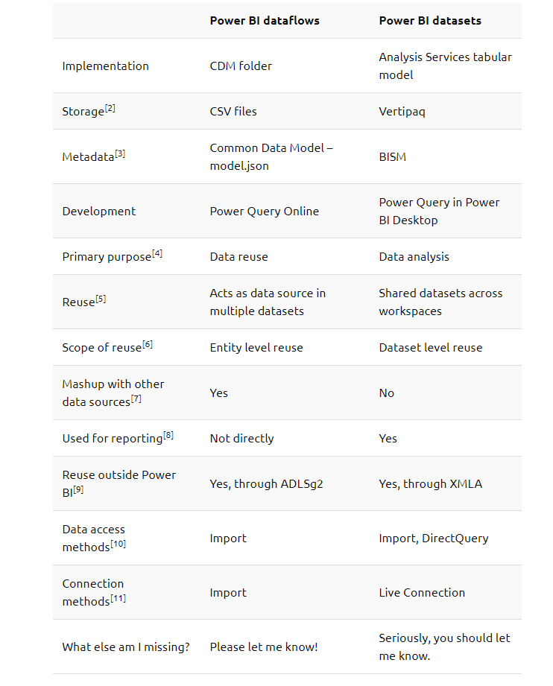
Storage Mode: Live Connection
https://ssbipolar.com/2019/10/14/power-bite-dataflows-vs-datasets/

Slide 43
Demo: dataflows, datasets, refresh... all in!

Slide 44
Can I have some advisable scenarios?

Slide 45
Some guidelines
Relational DWH | AAS/SSAS | Model Size | Advice
Yes | No | Under 1 GB | Storage Mode: Import Data License: Pro Data Preparation: Power Query or dataflows
No | No | Under 1 GB | Storage Mode: Import Data (also shared dataset) License: Pro Data Preparation: dataflows
Yes | Yes | - | Storage Mode: Live Query Connection License: Pro
Yes/No | No | Over 1 GB | Storage Mode: Import Data License: Premium Data Preparation: Power Query or dataflows
Yes/No | No | Over 1 GB | Storage Mode: Direct Query or Dual Mode with Aggregations License: Pro Data Preparation: Power Query

Slide 46
Useful Links
Live or Import? http://tiny.cc/fa9uaz
Gateway http://tiny.cc/lb9uaz
PowerShell Cmdlets for data gateway: http://tiny.cc/ebia1
Incremental Refresh: http://tiny.cc/4c9uaz
dataflows & CDM: http://tiny.cc/5d9uaz
Dataflows best practices: http://tiny.cc/dmgebi
Shared Datasets replace SSAS: http://tiny.cc/8imtbz

Slide 47
Q&A

Slide 48
Riccardo Perico rperico@solidq.com | @R1k91 |
Data Platform & BI Specialist @
10 years in Microsoft «Data Realm»
MCP: MTA, MCSA
Speaker at Azure Saturday, SQL Saturday and DIAD tutor

Slide 49
Thanks!

